Slide 1
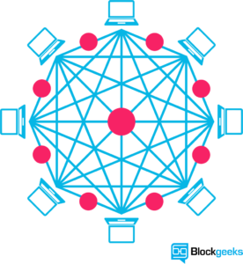
Supply chain Management using Block chain

Slide 2
ABSTRACT
The integration of blockchain technology into supply chain management (SCM) presents transformative opportunities to enhance transparency, security, and efficiency across the entire supply chain.
Traditional SCM systems often struggle with issues such as data silos, fraud, and lack of real-time visibility.
By leveraging the decentralized, immutable, and transparent nature of blockchain, supply chains can achieve real-time traceability of products, reduce the risk of fraud, and eliminate the need for intermediaries.
This presentation explores the current limitations of traditional SCM systems and proposes a blockchain-based solution to address these challenges, highlighting the potential benefits and real-world applications in industries such as food safety, logistics, and ethical sourcing.

Slide 3
INTRODUCTION
Supply Chain Management (SCM) is the backbone of global trade, encompassing the flow of goods and services from raw materials to final products delivered to consumers.
Traditional SCM systems, while essential, face significant challenges such as lack of transparency, inefficiencies, and susceptibility to fraud.
Enter blockchain technology, a decentralized and secure ledger system that promises to revolutionize supply chain operations.
By leveraging blockchain, we can achieve unprecedented levels of transparency, traceability, and efficiency.
This transformation addresses the core issues of traditional SCM, paving the way for more reliable, cost-effective, and trust-driven supply chains.

Slide 4
What is Blockchain?
A blockchain is a growing list of records, called blocks, which are linked using cryptographic hash.
Each block contains a cryptographic hash of the previous block, a timestamp, and transaction data (generally represented as a Merkle tree root hash).
Blockchain was invented by Satoshi Nakamoto in 2008 to serve as the public transaction ledger of the cryptocurrency bitcoin.

Slide 5
Cryptographic Hash
A cryptographic hash function is a hash function which takes an input (or 'message') and returns a fixed-size alphanumeric string.
The string is called the 'hash value', 'message digest', 'digital fingerprint', 'digest' or 'checksum'.

Slide 6
Use of blockchain
Beside crypto currencies, blockchains offer the potential to record –
asset ownership,
asset transfers,
document links,
provide identity management
… and so much more.

Slide 7

Why Blockchain?
Immutable records
Very secure
Distributed and decentralized database
transparency and end-to-end visibility

Slide 8
EXISTING SYSTEM
Centralized Databases:
Information is stored in central databases controlled by individual entities.
Limited visibility across the entire supply chain.
Multiple Intermediaries:
Numerous third parties involved in verifying and validating transactions.
Examples include suppliers, manufacturers, distributors, and retailers.
Siloed Systems:
Each stakeholder maintains its own records.
Lack of integration and communication between systems.

Slide 9
EXISTING SYSTEM DISADVANTAGES
Challenges Faced
Data Silos: Information compartmentalized across different systems and stakeholders.
High Operational Costs: Manual processes and intermediary fees increase expenses.
Fraud: Difficulty in verifying authenticity and preventing counterfeiting.
Slow Processes: Manual checks and paperwork cause delays in the supply chain.

Slide 10
PROPOSED SYSTEM
The proposed supply chain management system utilizing blockchain technology introduces a decentralized, immutable ledger that ensures transparency and security across the entire supply chain.
By integrating smart contracts, the system automates contract execution, reducing the need for intermediaries and enhancing trust among stakeholders.
Real-time tracking and monitoring of goods are enabled through IoT devices, providing detailed visibility and traceability from origin to consumer, which helps prevent fraud and counterfeiting.
The cryptographic security of blockchain ensures data integrity, making records tamper-proof and immutable.
This transformation results in increased efficiency, cost reduction, and improved accountability, addressing many of the inefficiencies and challenges present in traditional supply chain management systems.

Slide 11
PROPOSED SYSTEM
Integration of Blockchain
Decentralized Ledger:
All transactions are recorded on a decentralized, immutable ledger.
No single point of control, ensuring data integrity and transparency.
Shared Data Environment:
Every participant in the supply chain has access to the same data.
Eliminates data silos and provides a single source of truth.

Slide 12
PROPOSED SYSTEM
Smart Contracts
Automated Contracts:
Self-executing contracts with the terms of the agreement directly written into code.
Automatically enforce and execute agreed-upon terms when conditions are met.
Efficiency and Trust:
Reduce the need for intermediaries.
Enhance trust and efficiency by automating contract execution.

Slide 13
PROPOSED SYSTEM
3. Enhanced Traceability
Real-Time Tracking:
Track the movement of goods in real-time from origin to destination.
Use IoT devices and blockchain to record and monitor each step of the supply chain.
Product Provenance:
Verify the origin and authenticity of products.
Prevent fraud and counterfeiting by providing a transparent record of the product’s journey.

Slide 14
Smart Contract
A smart contract is a computer protocol intended to digitally facilitate, verify, or enforce the negotiation or performance of a contract.
Smart contracts allow the performance of credible transactions without third parties.
These transactions are trackable and irreversible.
Smart contracts were first proposed by Nick Szabo, who coined the term, in 1994.
Notes:
Example: Auto debit from Credit Card for various bill payments

Slide 15
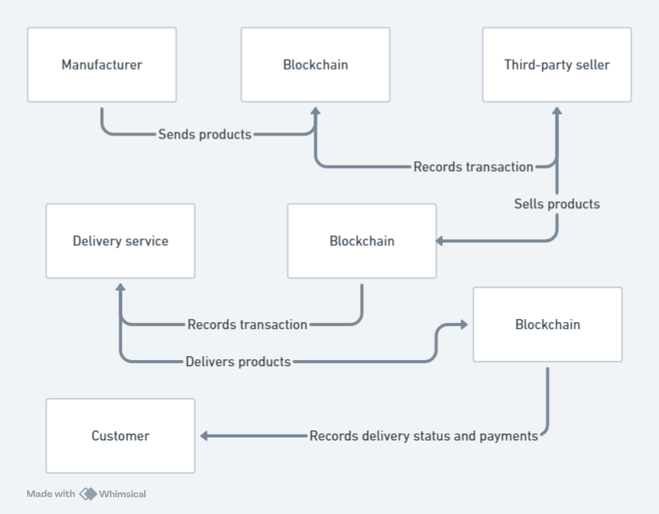
ARCHITECHTURE

Slide 16
HARDWARE SOFTWARE REQUIREMENTS
Hardware Requirements:
Processing Power: Intel I3 Processor Minimum
Memory: 8GB of RAM per node for optimal performance.
Storage: Minimum 20 GB storage on Hard Disk
Software Requirements:
IDEs : Visual Studio
Programming Languages : Solidity, Java Script
Databases : SQL

Slide 17
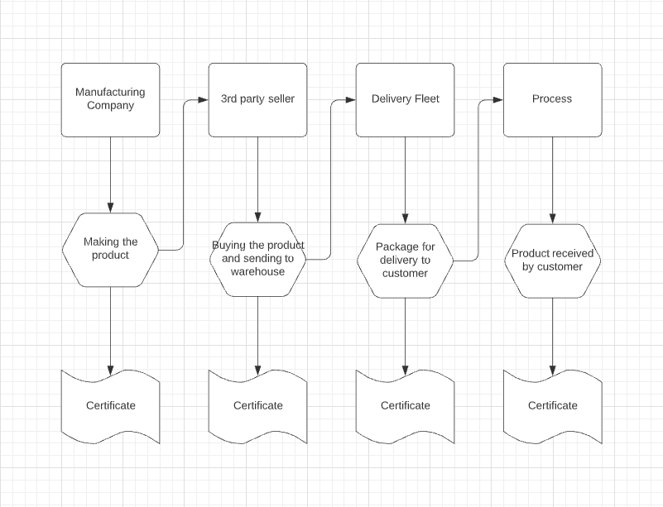
ACTIVITY DIAGRAM

Slide 18
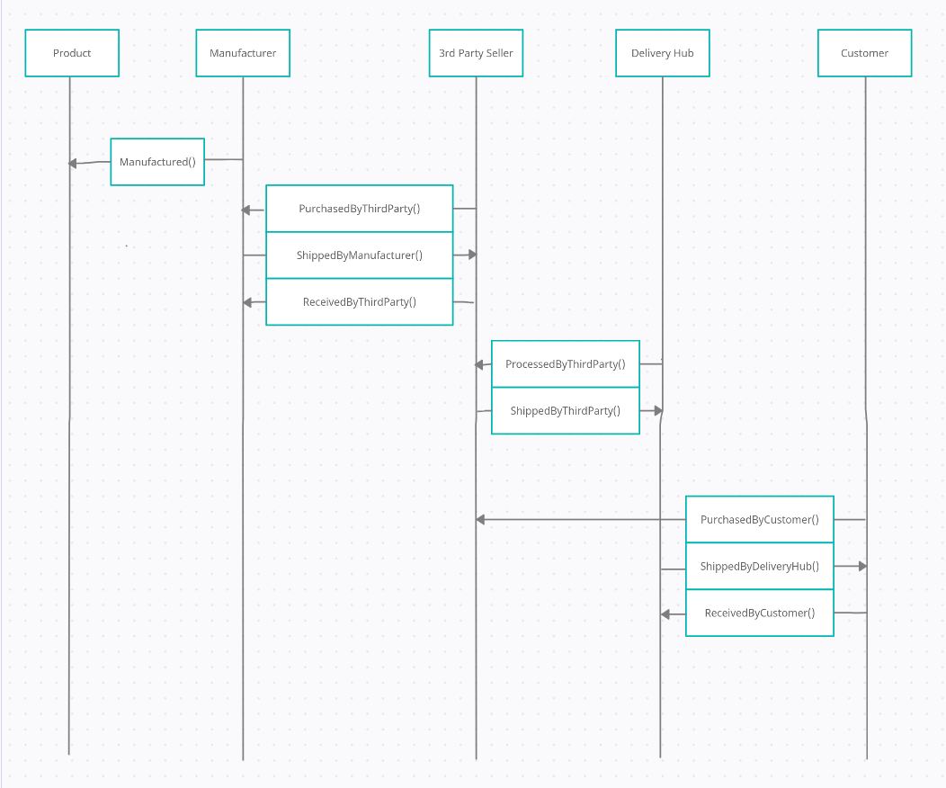
SEQUENCE DIAGRAM

Slide 19
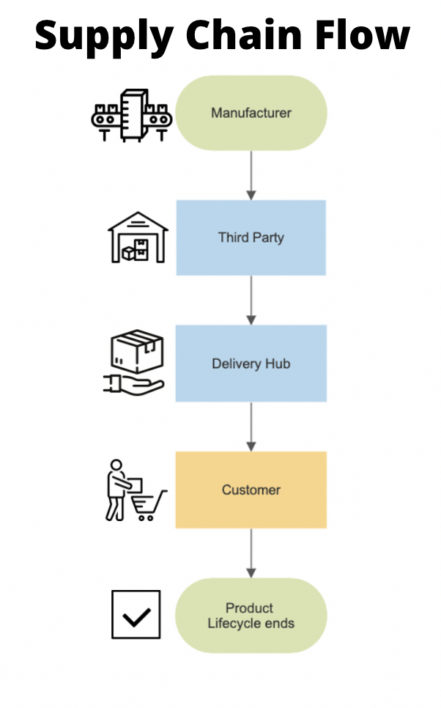
DATA FLOW DIAGRAM

Slide 20
CONCLUSION
The integration of blockchain technology into supply chain management has proven to be a transformative advancement, addressing many traditional challenges associated with transparency, security, and efficiency. Through this project, we have demonstrated several critical benefits of blockchain in supply chain contexts:
Enhanced Transparency and Traceability: Blockchain’s immutable ledger provides an unparalleled level of transparency.
Improved Security: The decentralized nature of blockchain enhances data security.
Increased Efficiency: Automation through smart contracts can streamline processes such as order fulfillment and payment settlements.

Slide 21
References
“An introduction to Blockchain and Distributed Ledger Technology” - CIPS Knowledge
“An Introduction To Blockchain And Its Potential Benefits And Drawbacks In Supply Chain Management & Logistics” – Cerasis
https://www.hyperledger.org/
https://www.scantrust.com/
https://www.oracle.com/cloud/blockchain/
https://cointelegraph.com/news/us-government-implements-blockchain-programs-to-improve-transparency-and-efficiency-expert-blog
https://hackernoon.com/5-governments-backing-blockchain-projects-401afa49d412
https://blockgeeks.com/guides/what-is-blockchain-technology/
https://www.g2crowd.com/categories/blockchain
https://www.lpea.lu/2017/11/30/blockchain-unlocking-the-value-of-distributed-ledger-technology-in-private-equity/
https://www.bis.org/publ/qtrpdf/r_qt1709y.htm
https://www.forbes.com/sites/bernardmarr/2018/02/16/a-very-brief-history-of-blockchain-technology-everyone-should-read/

Slide 22
References
https://www.waltonchain.org/
https://origintrail.io/use-cases
https://www.supplychaindigital.com/blockchain-0
https://www.ibm.com/blockchain/industries/supply-chain
https://www-01.ibm.com/common/ssi/cgi-bin/ssialias?htmlfid=93014193USEN
https://www.forbes.com/sites/bernardmarr/2018/03/23/how-blockchain-will-transform-the-supply-chain-and-logistics-industry/#6783a6935fec
https://www.reddit.com/r/waltonchain/comments/98jgtq/how_can_a_blockchain_help_with_supply_chains/
https://www.investinblockchain.com/supply-chain-blockchain-projects/
https://www.verypossible.com/blog/top-blockchain-use-cases-for-supply-chain-management
https://medium.com/trivial-co/blockchain-of-things-cool-things-happen-when-iot-distributed-ledger-tech-collide-3784dc62cc7b
https://www.fdfworld.com/food/carrefour-use-blockchain-technology-trace-food-through-supply-chain
https://www.ey.com/Publication/vwLUAssets/ey-blockchain-and-the-supply-chain-three/$FILE/ey-blockchain-and-the-supply-chain-three.pdf

